Slide 1
Testing

Slide 2
Software Testing
Software Testing involves much more than just a check on whether something works or not.
The testing process can involve
Evaluating software
Making suggestions for future design
Finding inefficiencies in code
Discovering unusual situations where code doesn’t work
Considering the user’s experience
Making suggestions for look and feel of a program or app

Slide 3
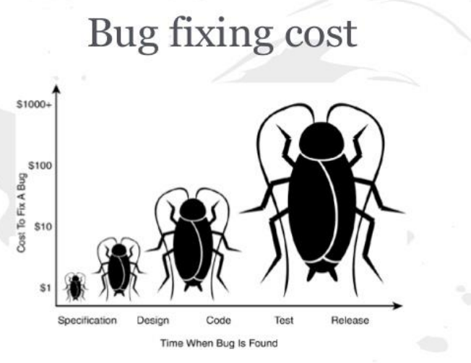
Software Testing
The software tester has a lot of responsibility.
The cost of fixing bugs increases hugely depending on the stage of software development

Slide 4
Software Testing
Recent changes to software development methodologies are reflected in a changing role for software testers.
In the traditional Waterfall model the testing process takes place at a particular point in the software development cycle.
In Agile development testers are involved from the start, in constant dialogue with clients, designers and project managers.
Unit testing is often carried out during the create stage of the development process. Other tests must be carried out after the software has been completed.
There is also Test Driven Development (TDD) where test cases are written before any code.

Slide 5

Windows XP - there were 65,000 bugs found before the product went to market
Boeing - problem where nose of aircraft went to high was overcorrected in a solution which was not properly tested. Two planes crashed.

Slide 6
Test Data
Test data are conditions/inputs that produce a known result and will be used to test each part of the software.
Test data is prepared in advance of testing and includes normal, incorrect, extreme and boundary values.
The software must be tested to ensure that it responds correctly to these types of test data.

Slide 7
Unit Testing
A unit refers to the smallest component of a program that can be tested e.g. a loop or a function.
Unit tests are typically automated tests written and run by software developers. Automated testing is a much faster process than manually testing and so more tests can be carried out.
Unit tests use test cases (similar to those you looked at in Evaluating Models).

Slide 8
Unit Testing
A unit test is another piece of code (usually a function itself), which passes arguments to the function to be tested. The unit test calculates the value that the function expected to return, the “expected” value. The function returns the “actual” value. The unit test then checks whether the actual value is equal to the expected value and records the result.
Code from the function should never be copied and pasted into the unit test. The code in the unit test should be written independently. This is to ensure errors in the code are identified using the test.

Slide 9
Benefits of Unit Testing
Compared to manual testing, the benefits of unit testing include:
It is fast
It allows errors to be identified easily
It makes it easy for members of a team to check each others code
It provides documentation
It provides confidence that the code works correctly

Slide 10
Unit Testing v Integration Testing
Unit testing tests the smallest element of the system. It could be testing a single function.
Integration testing is meant to show that the system’s components work with one another.
The goal is to find problems when components that work correctly are put together.

Slide 11
Functional Testing
Functional testing involves testing each of the functions or features of the system. It includes:
Whether the function produces the expected result
Usability - how easy it is for the user to navigate
Accessibility - how easily a user can access the function
Error handling - whether appropriate error messages are displayed when they are needed.
Security - if the function is as secure as it is meant to be.

Slide 12
Functional Testing
Functional Testing begins with identifying the functions in the system and then for each function:
Creating test data
Determining the expected output from test data
Carrying out the test
Comparing actual result with expected result
Checking if the function worked correctly
Documenting results of the test

Slide 13
Functional / Non Functional Testing
Functional testing tests the system’s functionality and behaviour.
Non - functional testing tests aspects of the system such as usability, reliability, maintainability and performance.

Slide 14
System Testing
System testing tests the entire system. The aim of system testing is to ensure that the software meets the specification agreed with the client and the users.
System testing can be broken into alpha testing and beta testing.
Alpha testing is carried out by a test team in house. It aims to test as many paths through the system as possible. The purpose is to discover and fix problems before the system is tested by users.

Slide 15
System Testing
Beta testing is when an early (beta version) version of the software is sent to potential users who agree to use the software and report any faults.
Users perform tests that are typical of what would take place in real life conditions. They record problems and notify the developers so that they can be fixed.
Real users may try to do something that a developer did not anticipate.

Slide 16
Black box v White box Testing
Black box testing is carried out independently of the code used in the program.
It looks at the program specification and creates a set of test data that covers all the inputs, outputs and program functions.
It basically checks if the program works or doesn’t.
System testing is a form of Black box testing.
White box testing depends on the code logic.
Tests are devised which test each path through the code at least once.
Unit Testing is a form of White box testing.

Slide 17
Regression Testing
Regression Testing is testing to confirm that code changes have not affecting existing features.
It is carried out using test cases that worked before the changes to ensure existing functionality still works as expected.
This type of testing is done to make sure that new code changes should not have side effects on the existing functionalities. It ensures that the old code still works after changes are made.

Slide 18
Evaluation
Once a project is completed, the user now needs to test every aspect of the software to make sure it does what it is supposed to do.
It will be evaluated against the original specification document
This stage can be called Acceptance Testing.

Slide 19
Worth a read
https://www.brighthubpm.com/monitoring-projects/104432-software-testing-a-simple-five-stage-model/

